Slide 1
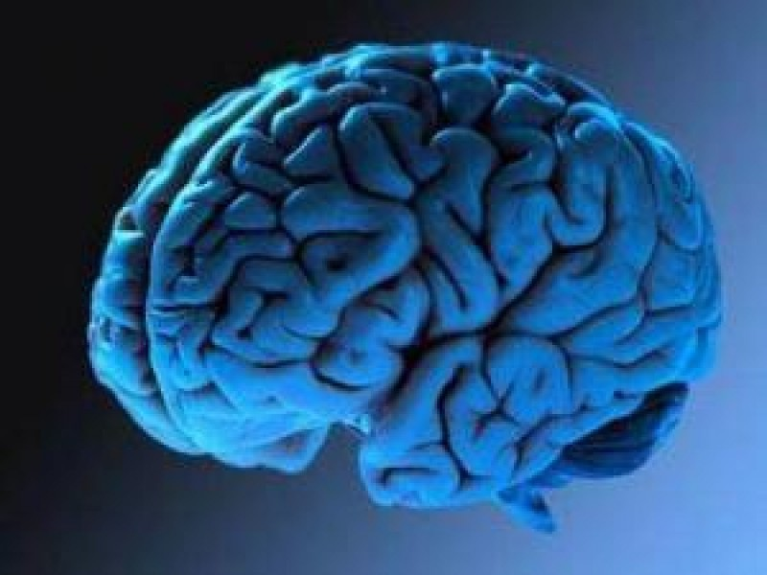

Slide 2
Plan for today
Ist part
Brief introduction to Biological systems.
Historical Background.
Deep Belief learning procedure.
IInd part
Theoretical considerations.
Different interpretation.

Slide 3
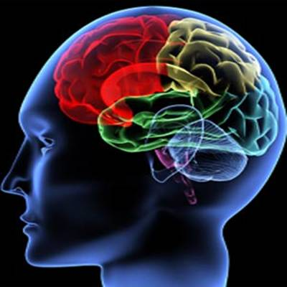
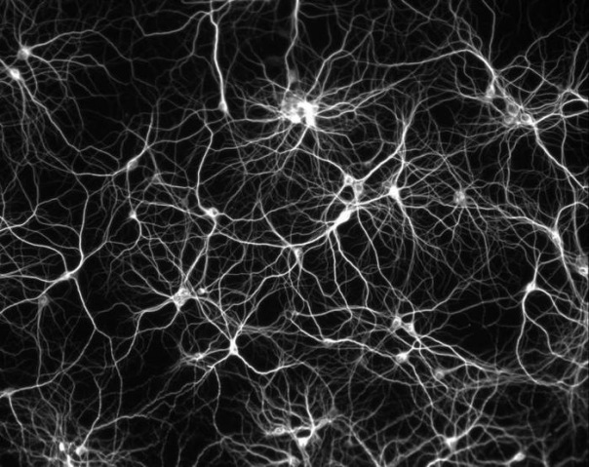
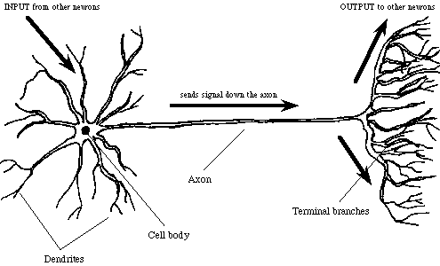
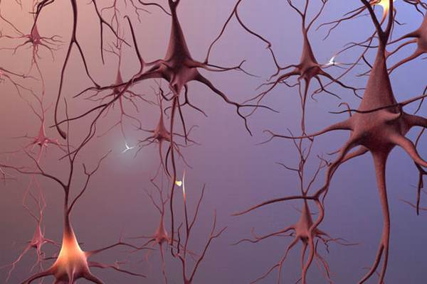
Biological Neurons

Slide 4
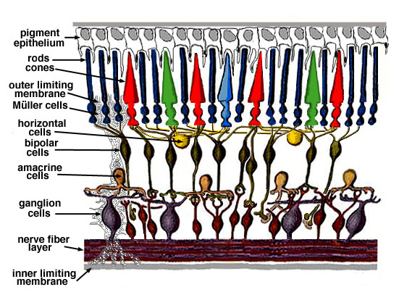
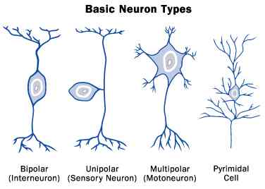
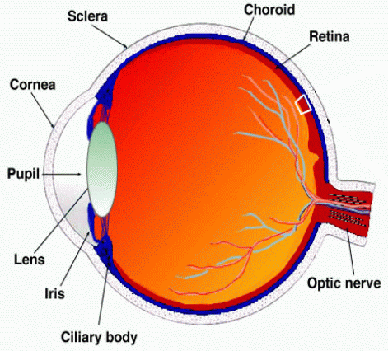
The Retina
Most common in the
Preliminary parts of
The data processing
Retina, ears

Slide 5
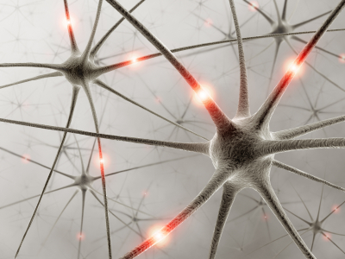
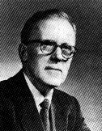
What is known about the learning process
Activation
every activity lead to the firing of a certain set of neurons.
Habituation:
is the psychological process in humans and other organisms in which there is a decrease in psychological and behavioral response to a stimulus after repeated exposure to that stimulus over a duration of time.
Hebbian Learning
When activities were repeated, the connections between those neurons strengthened. This repetition was what led to the formation of memory.
In 1949 introduced Hebbian Learning:
synchronous activation increases the synaptic strength;
asynchronous activation decreases the synaptic strength.

Slide 6


A spectrum of machine learning tasks
Typical Statistics
Artificial Intelligence
Low-dimensional data (e.g. less than 100 dimensions)
Lots of noise in the data
There is not much structure in the data, and what structure there is, can be represented by a fairly simple model.
The main problem is distinguishing true structure from noise.
High-dimensional data (e.g. more than 100 dimensions)
The noise is not sufficient to obscure the structure in the data if we process it right.
There is a huge amount of structure in the data, but the structure is too complicated to be represented by a simple model.
The main problem is figuring out a way to represent the complicated structure so that it can be learned.
Link

Slide 7
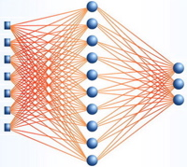
Artificial Neural Networks
Artificial Neural Networks have been applied successfully to :
speech recognition
image analysis
adaptive control
INPUTS
W
Neuron
W
f(n)
Σ
Outputs
Activation Function
W
W
W=Weight

Slide 8
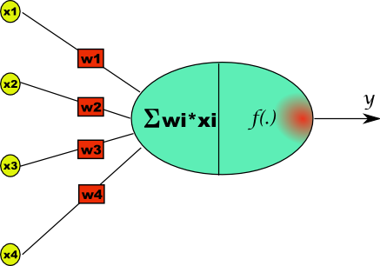
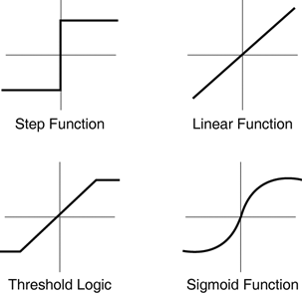
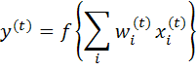
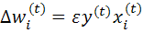
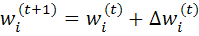
Hebbian Learning
Hebbian Learning
When activities were repeated, the connections between those neurons strengthened. This repetition was what led to the formation of memory.
In 1949 introduced Hebbian Learning:
synchronous activation increases the synaptic strength;
asynchronous activation decreases the synaptic strength.
Update

Slide 9
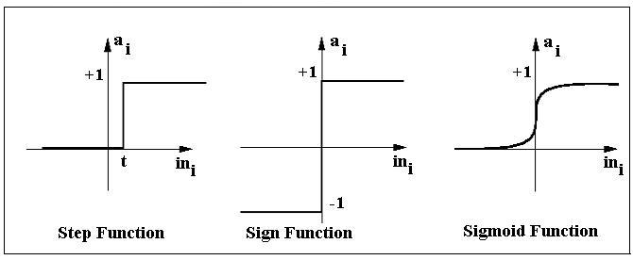
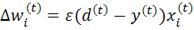
The simplest model- the Perceptron
The Perceptron was introduced in 1957 by
Frank Rosenblatt.
Perceptron:
-
D0
d
D1
Activation
functions:
D2
Learning:
Input
Layer
Output
Layer
Destinations
Update

Slide 10
The simplest model- the Perceptron
Is a linear classifier.
Can only perfectly classify a set of linearly separable data.
Link
How to learn multiple layers?
-
d
incapable of processing the Exclusive Or (XOR) circuit.
Link

Slide 11
Second generation neural networks (~1985) Back Propagation
Back-propagate error signal to get derivatives for learning
Compare outputs with correct answer to get error signal
outputs
hidden layers
input vector

Slide 12
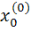
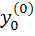
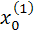
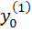
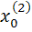
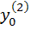
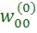
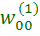
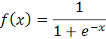
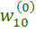
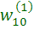
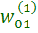
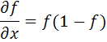
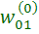
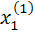
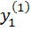
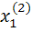
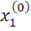
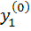
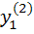
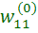
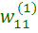
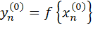
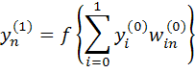
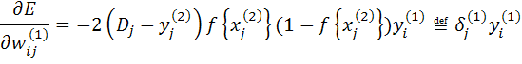
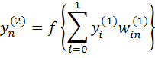
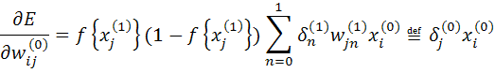
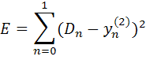
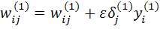
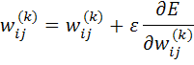
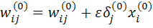
BP-algorithm
1
.5
0
-5
0
5
.25
0
-5
5
0
Activations
errors
The error:
Update
Update
Weights:

Slide 13
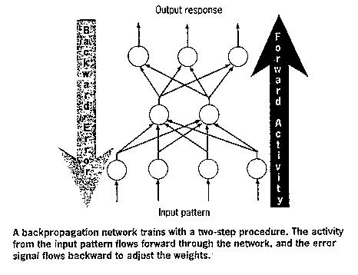
Back Propagation
Advantages
Multi layer Perceptron network can be trained by
The back propagation algorithm to perform any mapping between the input and the output.
What is wrong with back-propagation?
It requires labeled training data.
Almost all data is unlabeled.
The learning time does not scale well
It is very slow in networks with multiple hidden layers.
It can get stuck in poor local optima.
A temporary digression
Vapnik and his co-workers developed a very clever type of perceptron called a Support Vector Machine.
In the 1990’s, many researchers abandoned neural networks with multiple adaptive hidden layers because Support Vector Machines worked better.

Slide 14
Overcoming the limitations of back-propagation-Restricted Boltzmann Machines
Keep the efficiency and simplicity of using a gradient method for adjusting the weights, but use it for modeling the structure of the sensory input.
Adjust the weights to maximize the probability that a generative model would have produced the sensory input.
Learn p(image) not p(label | image)

Slide 15
Restricted Boltzmann Machines(RBM)
RBM is a Multiple Layer Perceptron Network
The inference problem: Infer the states of the unobserved variables.
The learning problem: Adjust the interactions between variables to make the network more likely to generate the observed data.
RBM is a Graphical model
Output layer
Hidden layer
Input layer

Slide 16
graphical models
RMF:
undirected
Each arrow represent mutual
dependencies between nodes
hidden
Bayesian network
or belief network
or Boltzmann Machine:
directed
acyclic
hidden
data
HMM:
the simplest
Bayesian network
Restricted
Boltzmann Machine:
symmetrically directed
acyclic
no intra-layer connections

Slide 17




Stochastic binary units (Bernoulli variables)
1
j
0
i
0
These have a state of 1 or 0.
The probability of turning on is determined by the weighted input from other units (plus a bias)

Slide 18





The Energy of a joint configuration (ignoring terms to do with biases)
The energy of the
current state:
The joint probability distribution
Probability distribution
over the visible vector v:
Partition function
The derivative of the
energy function:
j
i

Slide 19




Maximum Likelihood method
iteration t
learning rate
Parameters (weights)
update:
The log-likelihood:
average w.r.t the
data distribution
computed using
the sample data x
average w.r.t the
model distribution
can’t generally
be computed

Slide 20


Hinton's method - Contrastive Divergence
Max likelihood method
minimizes the Kullback-Leibber
divergence:
Intuitively:

Slide 21

Contrastive Divergence (CD) method
In 2002 Hinton proposed a new learning procedure.
CD follows approximately the difference of two divergences
(="the gradient").
is the "distance" of the distribution from
Practically: run the chain only for a small number of steps (actually one is sufficient)
The update formula for the weights become:
This greatly reduces both the computation per gradient step and the variance
of the estimated gradient.
Experiments show good parameter estimation capabilities.

Slide 22



A picture of the maximum likelihood learning algorithm for an RBM
j
j
j
j
i
i
i
i
the fantasy
(i.e. the model)
t = 0 t = 1 t = 2 t = ∞
Start with a training vector on the visible units.
Then alternate between updating all the hidden units in parallel and updating all the visible units in parallel.
One Gibbs Sample (CD):

Slide 23
Multi Layer Network
After Gibbs Sampling for
Sufficiently long, the network
reaches thermal equilibrium: the
state of still change, but the
probability of finding the system
in any particular configuration does not.
h3
h2
Adding another layer always
improves the variation bound
on the log-likelihood, unless the
top level RBM is already a perfect
model of the data it’s trained on.
h1
data

Slide 24


The network for the 4 squares task
4 labels
4 logistic units
2 input units

Slide 25

The network for the 4 squares task
4 labels
4 logistic units
2 input units

Slide 26

The network for the 4 squares task
4 labels
4 logistic units
2 input units

Slide 27

The network for the 4 squares task
4 labels
4 logistic units
2 input units

Slide 28

The network for the 4 squares task
4 labels
4 logistic units
2 input units

Slide 29

The network for the 4 squares task
4 labels
4 logistic units
2 input units

Slide 30

The network for the 4 squares task
4 labels
4 logistic units
2 input units

Slide 31

The network for the 4 squares task
4 labels
4 logistic units
2 input units

Slide 32

The network for the 4 squares task
4 labels
4 logistic units
2 input units

Slide 33

The network for the 4 squares task
4 labels
4 logistic units
2 input units

Slide 34

The network for the 4 squares task
4 labels
4 logistic units
2 input units

Slide 35

entirely unsupervised except for the colors

Slide 36


Results
The Network used
to recognize handwritten
binary digits from
MNIST database:
10 labels
output vector
2000 neurons
500 neurons
Class:
Non Class:
500 neurons
New test images from the digit class that the model was trained on
Images from an unfamiliar digit class (the network tries to see every image as a 2)
28x28 pixels

Slide 37

Examples of correctly recognized handwritten digits that the neural network had never seen before
Pros:
Good generalization capabilities
Cons:
Only binary values permitted.
No Invariance (neither translation nor rotation).

Slide 38
How well does it discriminate on MNIST test set with no extra information about geometric distortions?
Generative model based on RBM’s 1.25%
Support Vector Machine (Decoste et. al.) 1.4%
Backprop with 1000 hiddens (Platt) ~1.6%
Backprop with 500 -->300 hiddens ~1.6%
K-Nearest Neighbor ~ 3.3%

Slide 39


A non-linear generative model for human motion
CMU Graphics Lab Motion Capture Database
Sampled motion from video (30 Hz).
Each frame is a Vector 1x60 of the skeleton
Parameters (3D joint angles).
The data does not need to be heavily
preprocessed or dimensionality reduced.

Slide 40
Conditional RBM (cRBM)
t
Can model temporal dependences
by treating the visible variables in
the past as an additional biases.
Add two types of connections:
from the past n frames of visible
to the current visible.
from the past n frames of visible
to the current hidden.
Given the past n frames, the hidden
units at time t are cond. independent→
→ we can still use the CD for training cRBMs
t-2 t-1 t

Slide 41



Slide 42
THANK YOU

Slide 43




Structured input
Independent input
Much easier to learn!!!
Back (3)

Slide 44
The Perceptron is a linear classifier
1
0
.99
.01
Back (3)

Slide 45



A | B | OR(A,B)
0 | 0 | 0
0 | 1 | 1
1 | 0 | 1
1 | 1 | 1
A | B | XOR(A,B)
0 | 0 | 0
0 | 1 | 1
1 | 0 | 1
1 | 1 | 0
1
x1
0
x0
1
A | B | AND(A,B)
0 | 0 | 0
0 | 1 | 0
1 | 0 | 0
1 | 1 | 1
A | B | NAND(A,B)
0 | 0 | 1
0 | 1 | 1
1 | 0 | 1
1 | 1 | 0
1
x1
0
x0
1
Back (3)

